Slide 1
Pediatric Dentistry
Where Happy smiles are made!

Slide 2
Why Milk teeth should be saved?

Slide 3
Efficient Mastication of food

Slide 4
Normal Facial appearance
Low self confidence

Slide 8
Formulation of Clear speech

Slide 9
Maintenance of Space and arch continuity

Slide 11
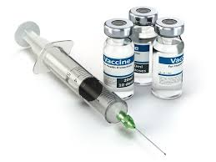
Prevention is Better than cure!
Dental caries vaccine?

Slide 12
Primary Prevention

Slide 13
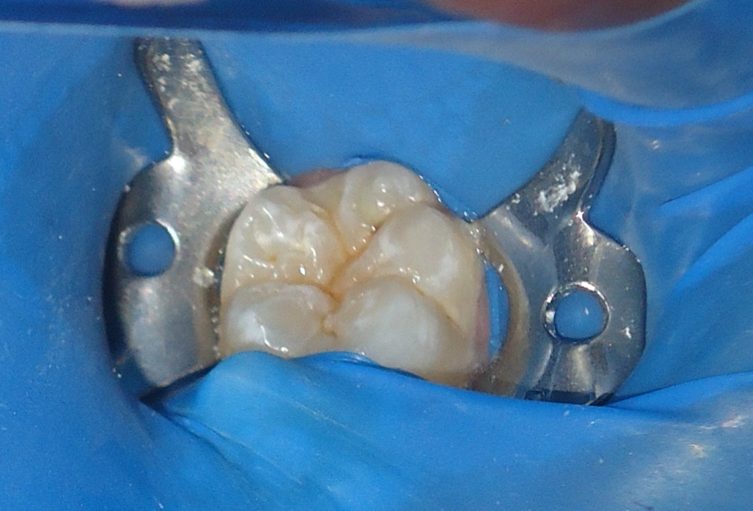
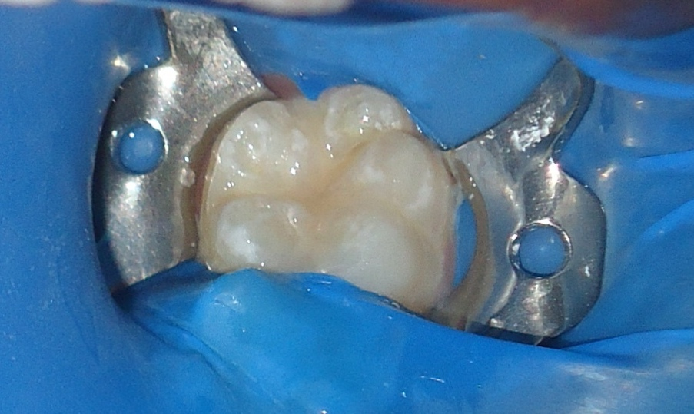
Fluoride application & Pit and Fissure Sealants

Slide 14
Secondary Prevention
Dental caries due Night feeding with bottle.
Poor oral hygiene
Frequent Sweets
Disability due to various diseases

Slide 15
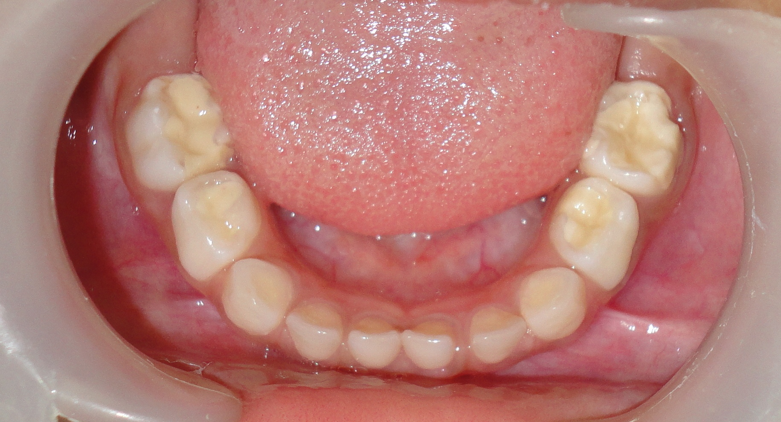
Restoration

Slide 16
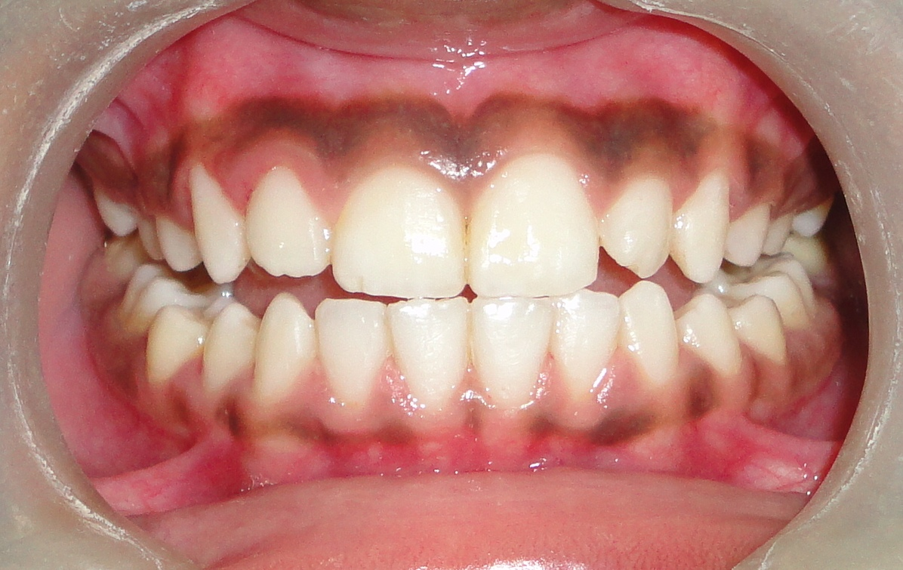
Oral Prophylaxis

Slide 17
Extraction

Slide 18
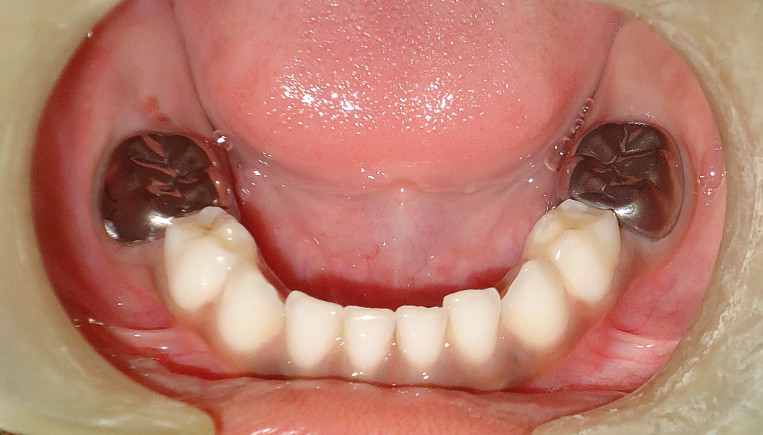
Tertiary prevention

Slide 19
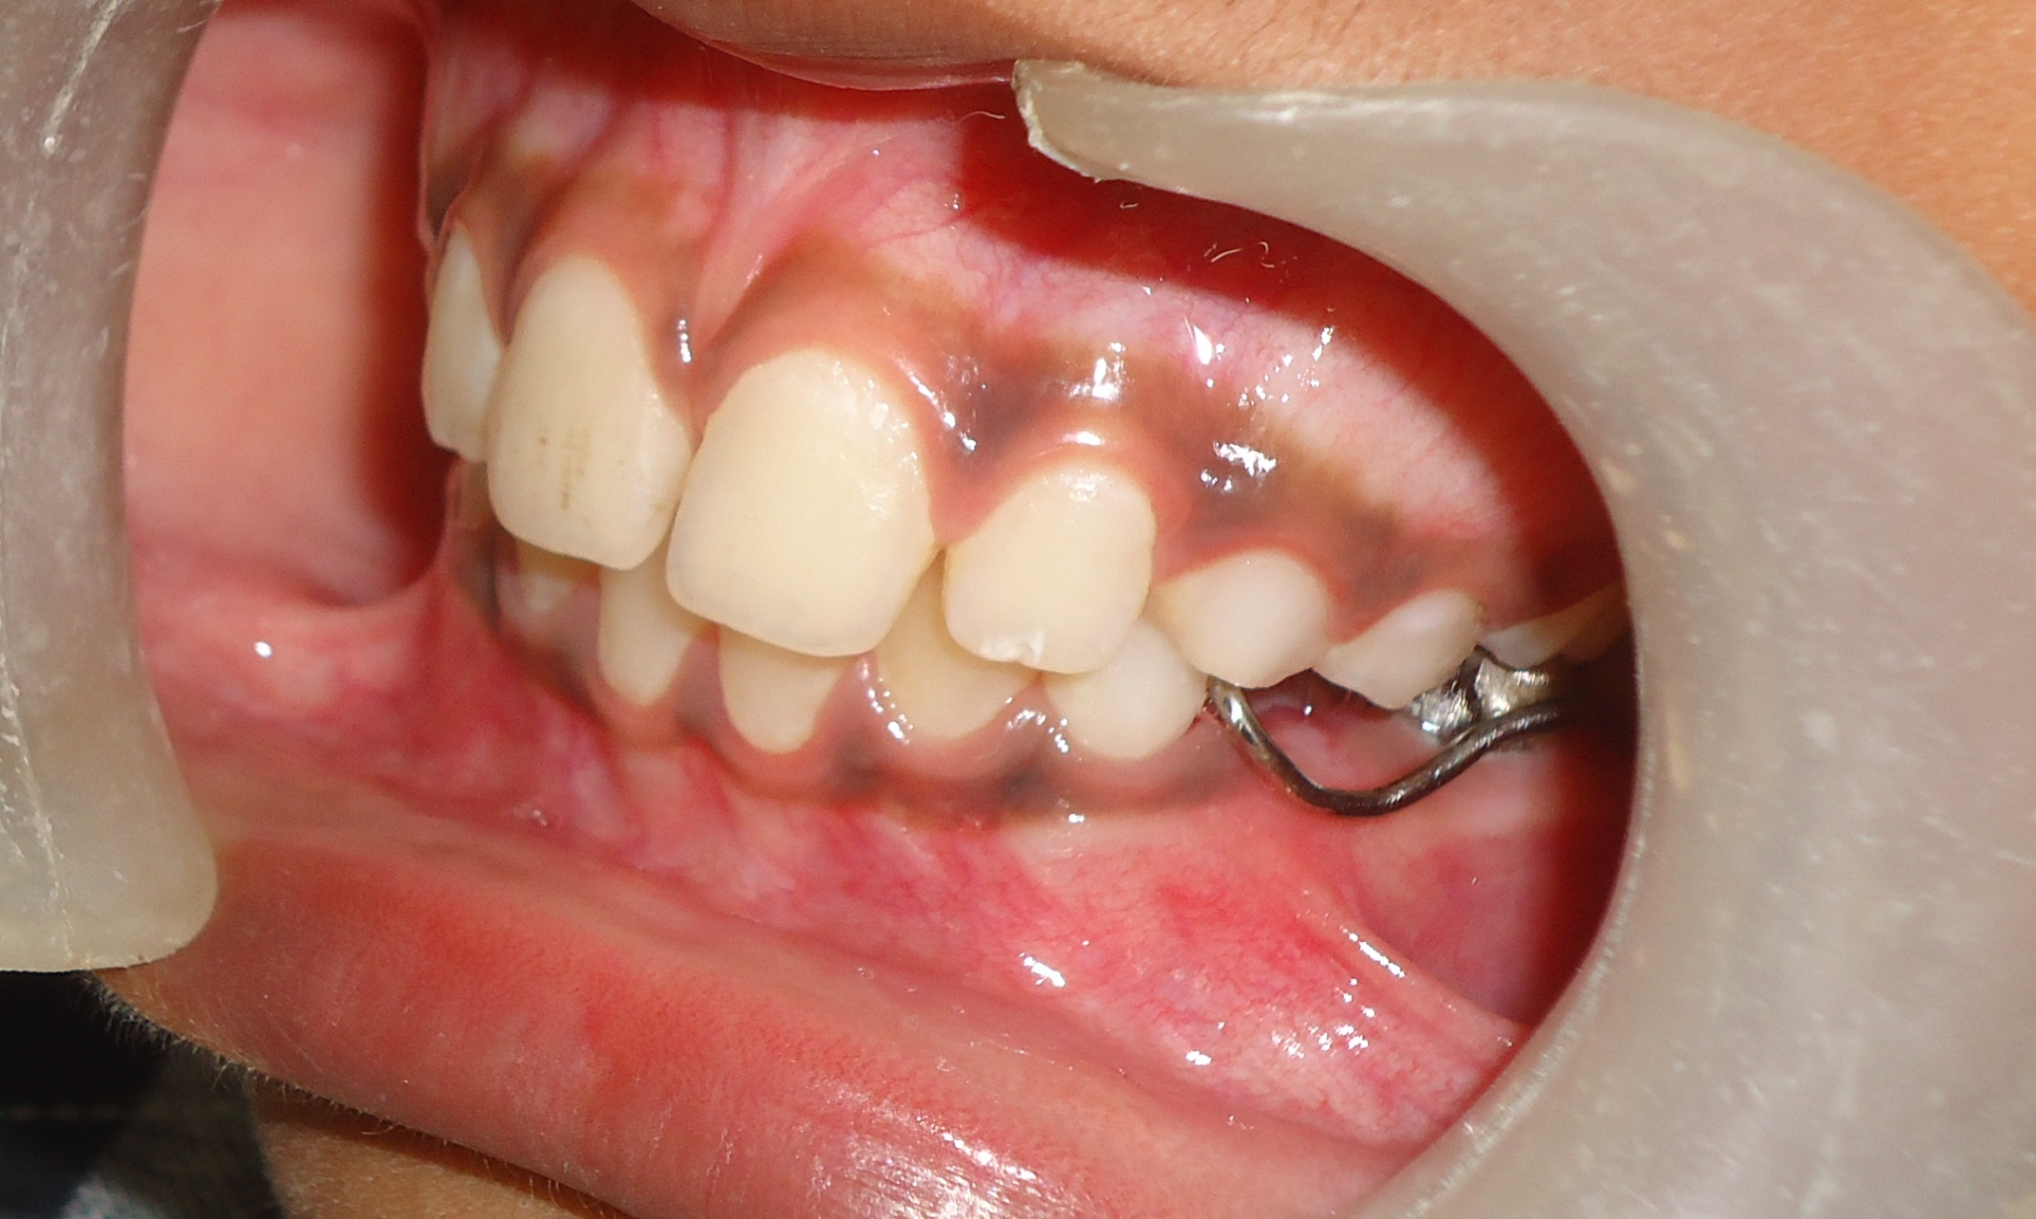
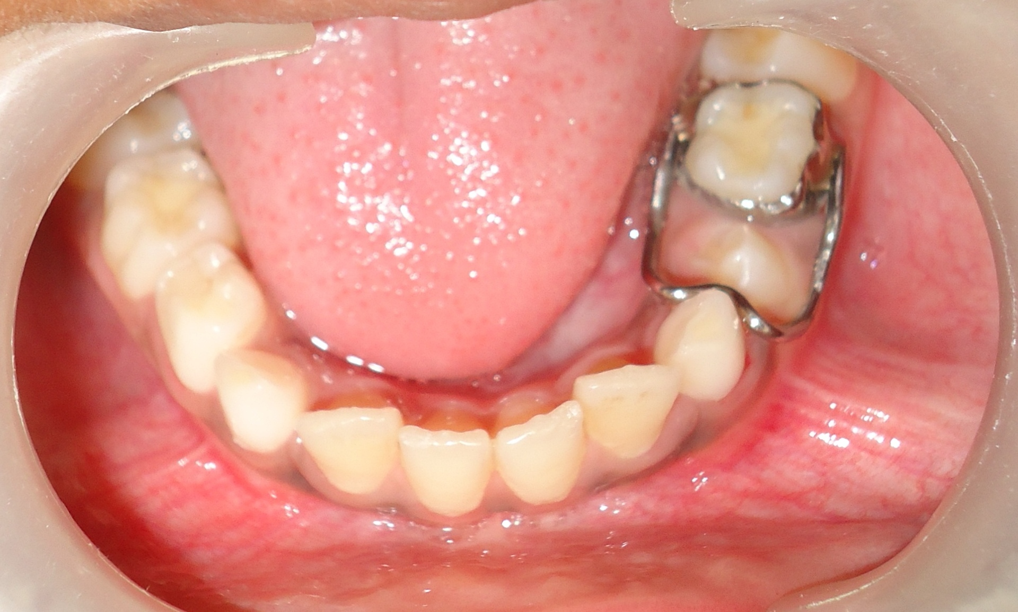
Space maintainer

Slide 20
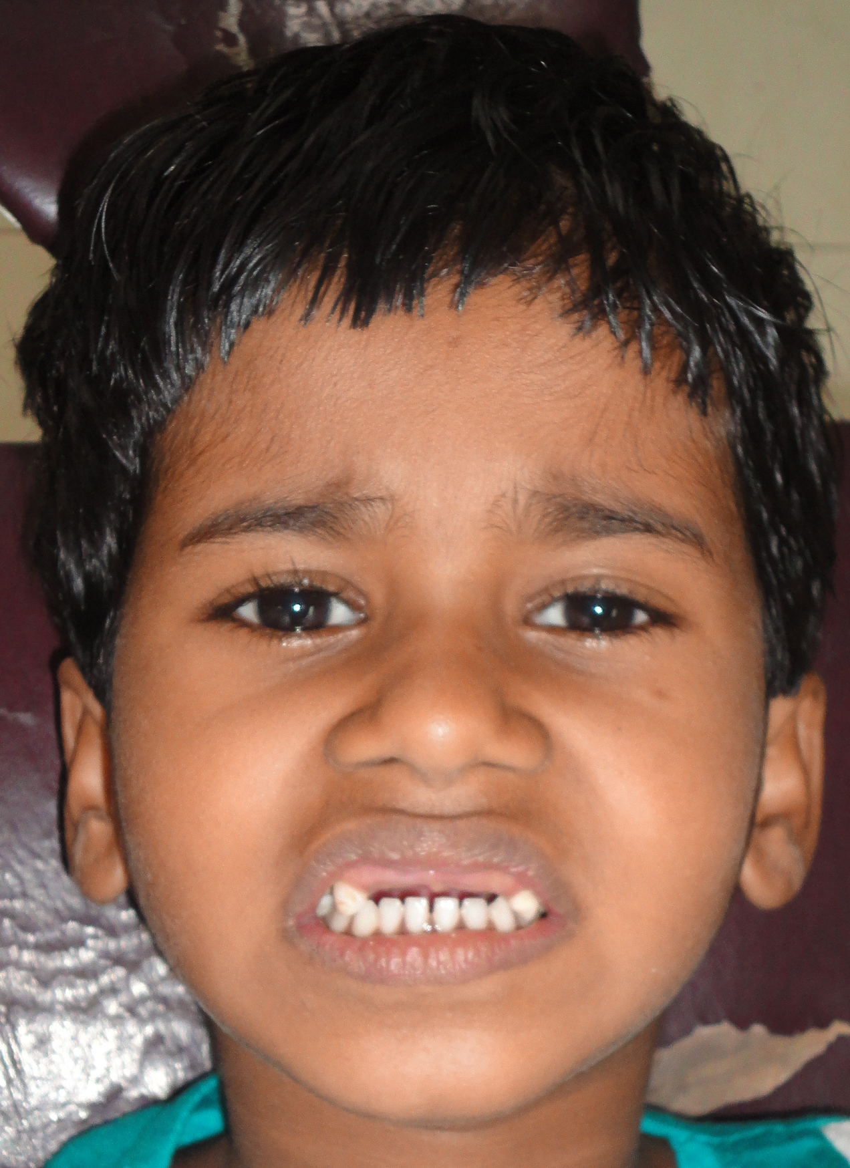
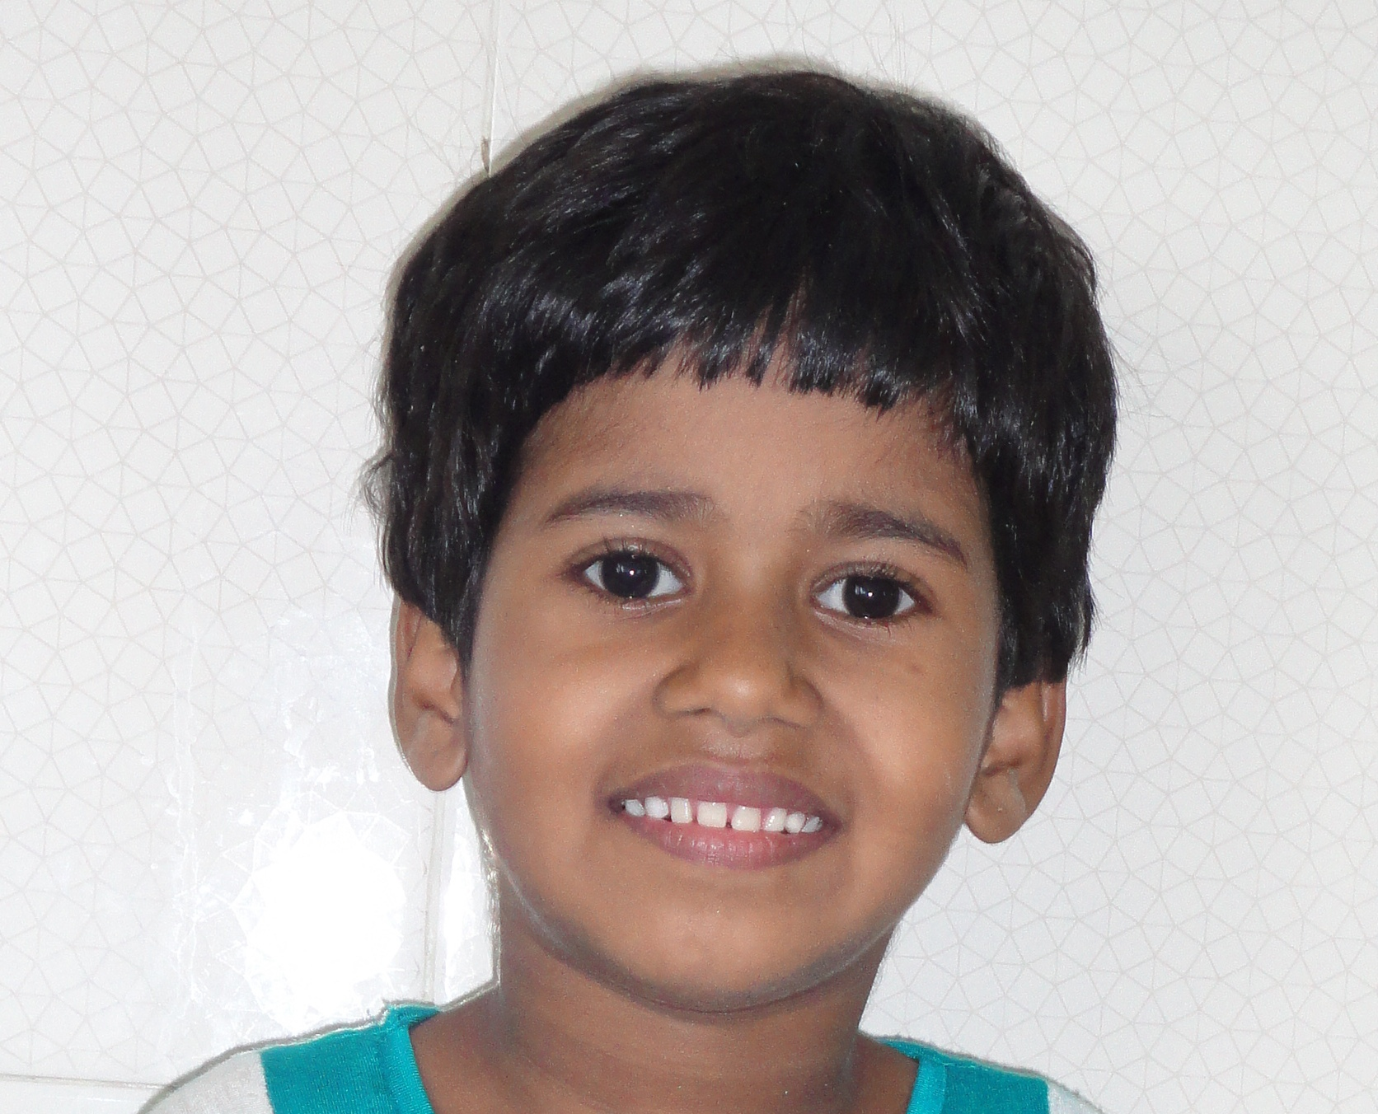
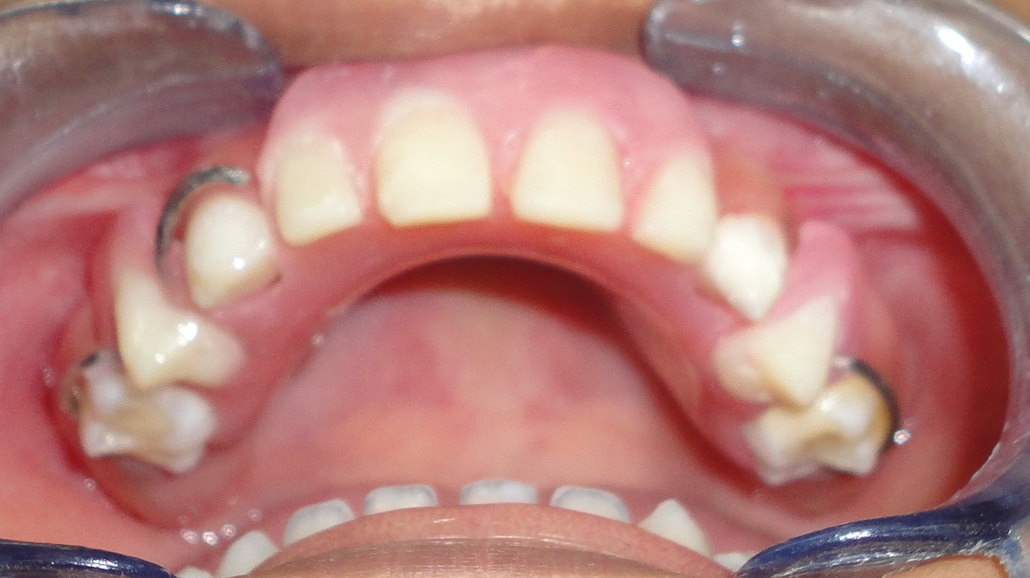
Replacement of teeth

Slide 21
There is more to Pediatric Dentistry…..

Slide 22
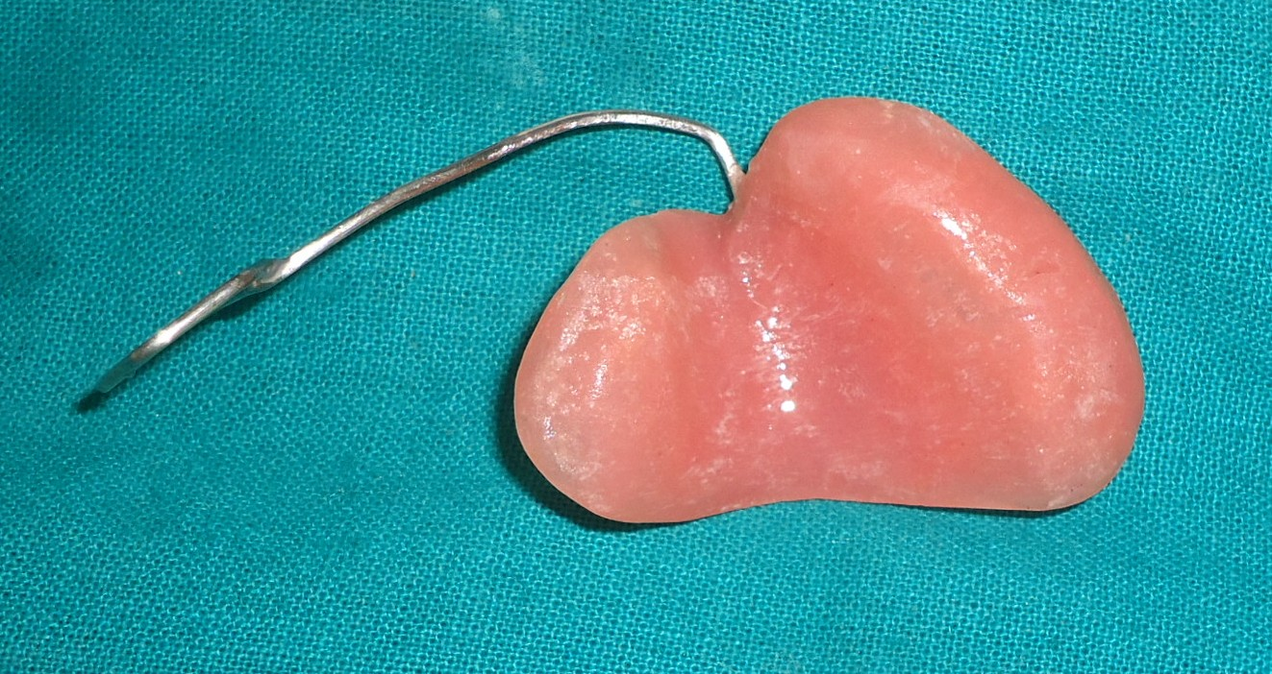
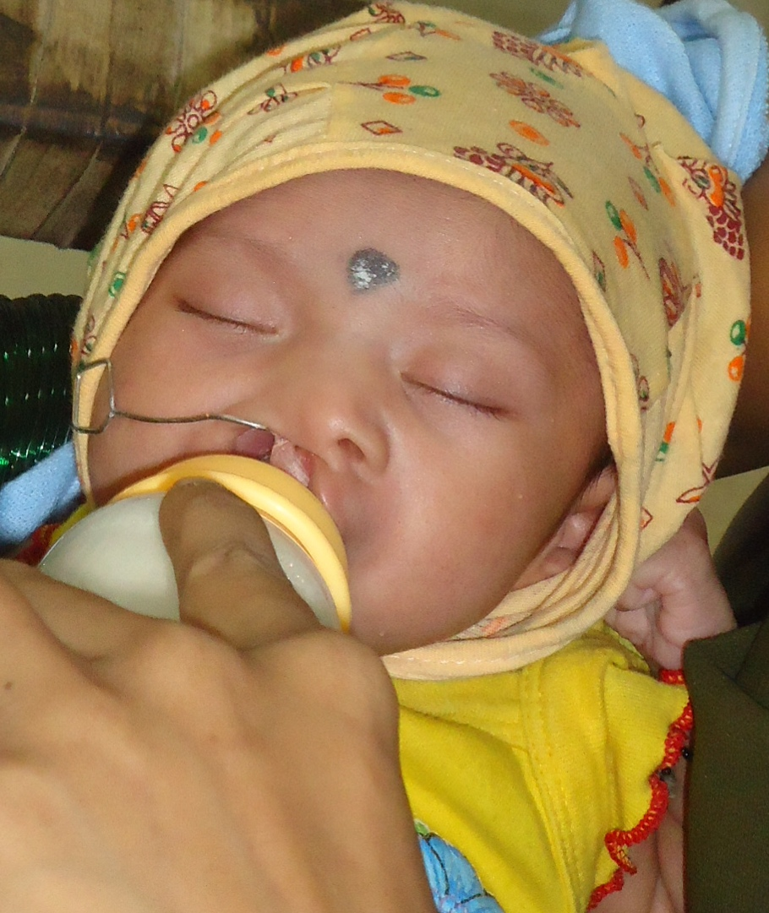
Obturators

Slide 23
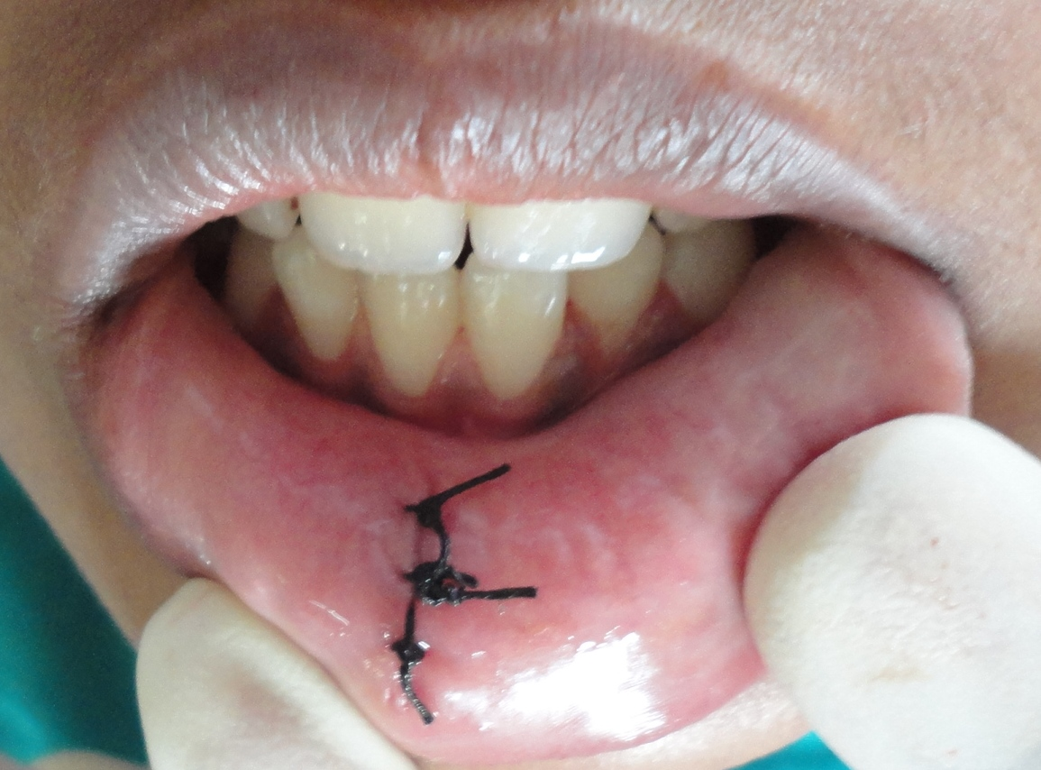
Mucocele

Slide 24
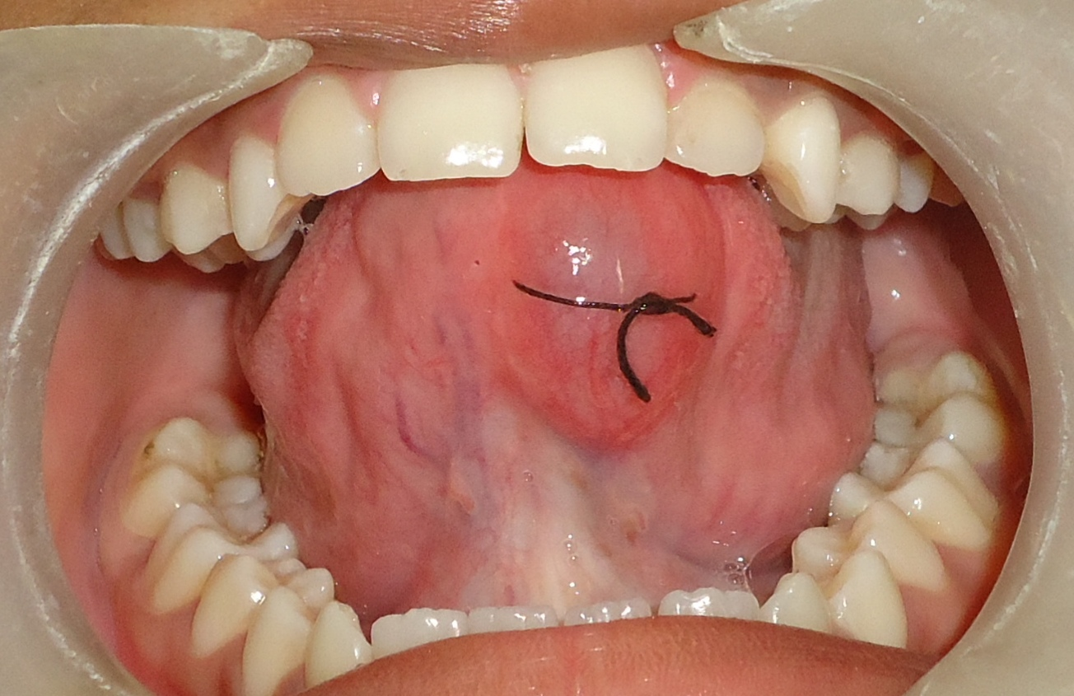
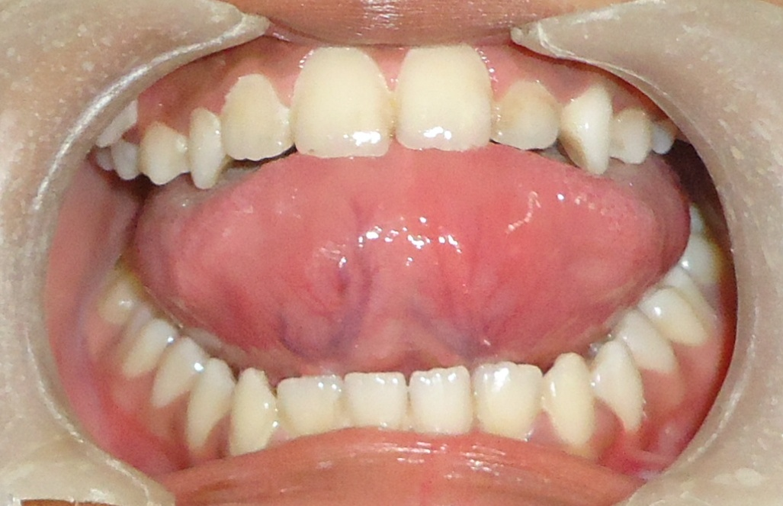

Slide 25
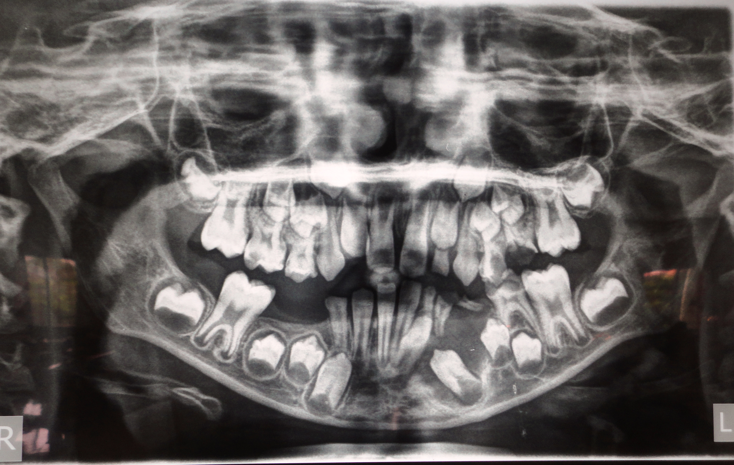
Cysts

Slide 26
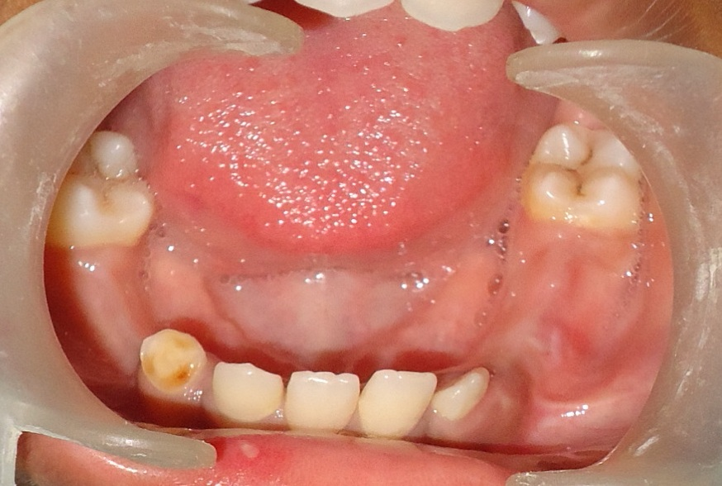

Slide 27
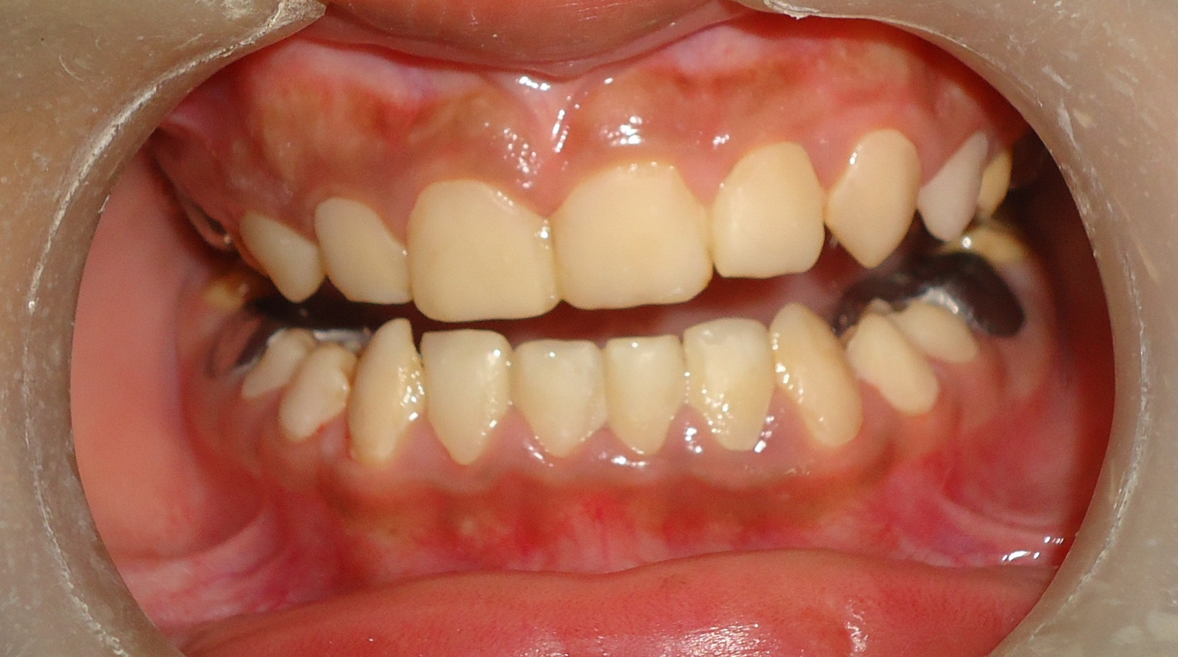
Amelogenesis Imperfecta

Slide 28
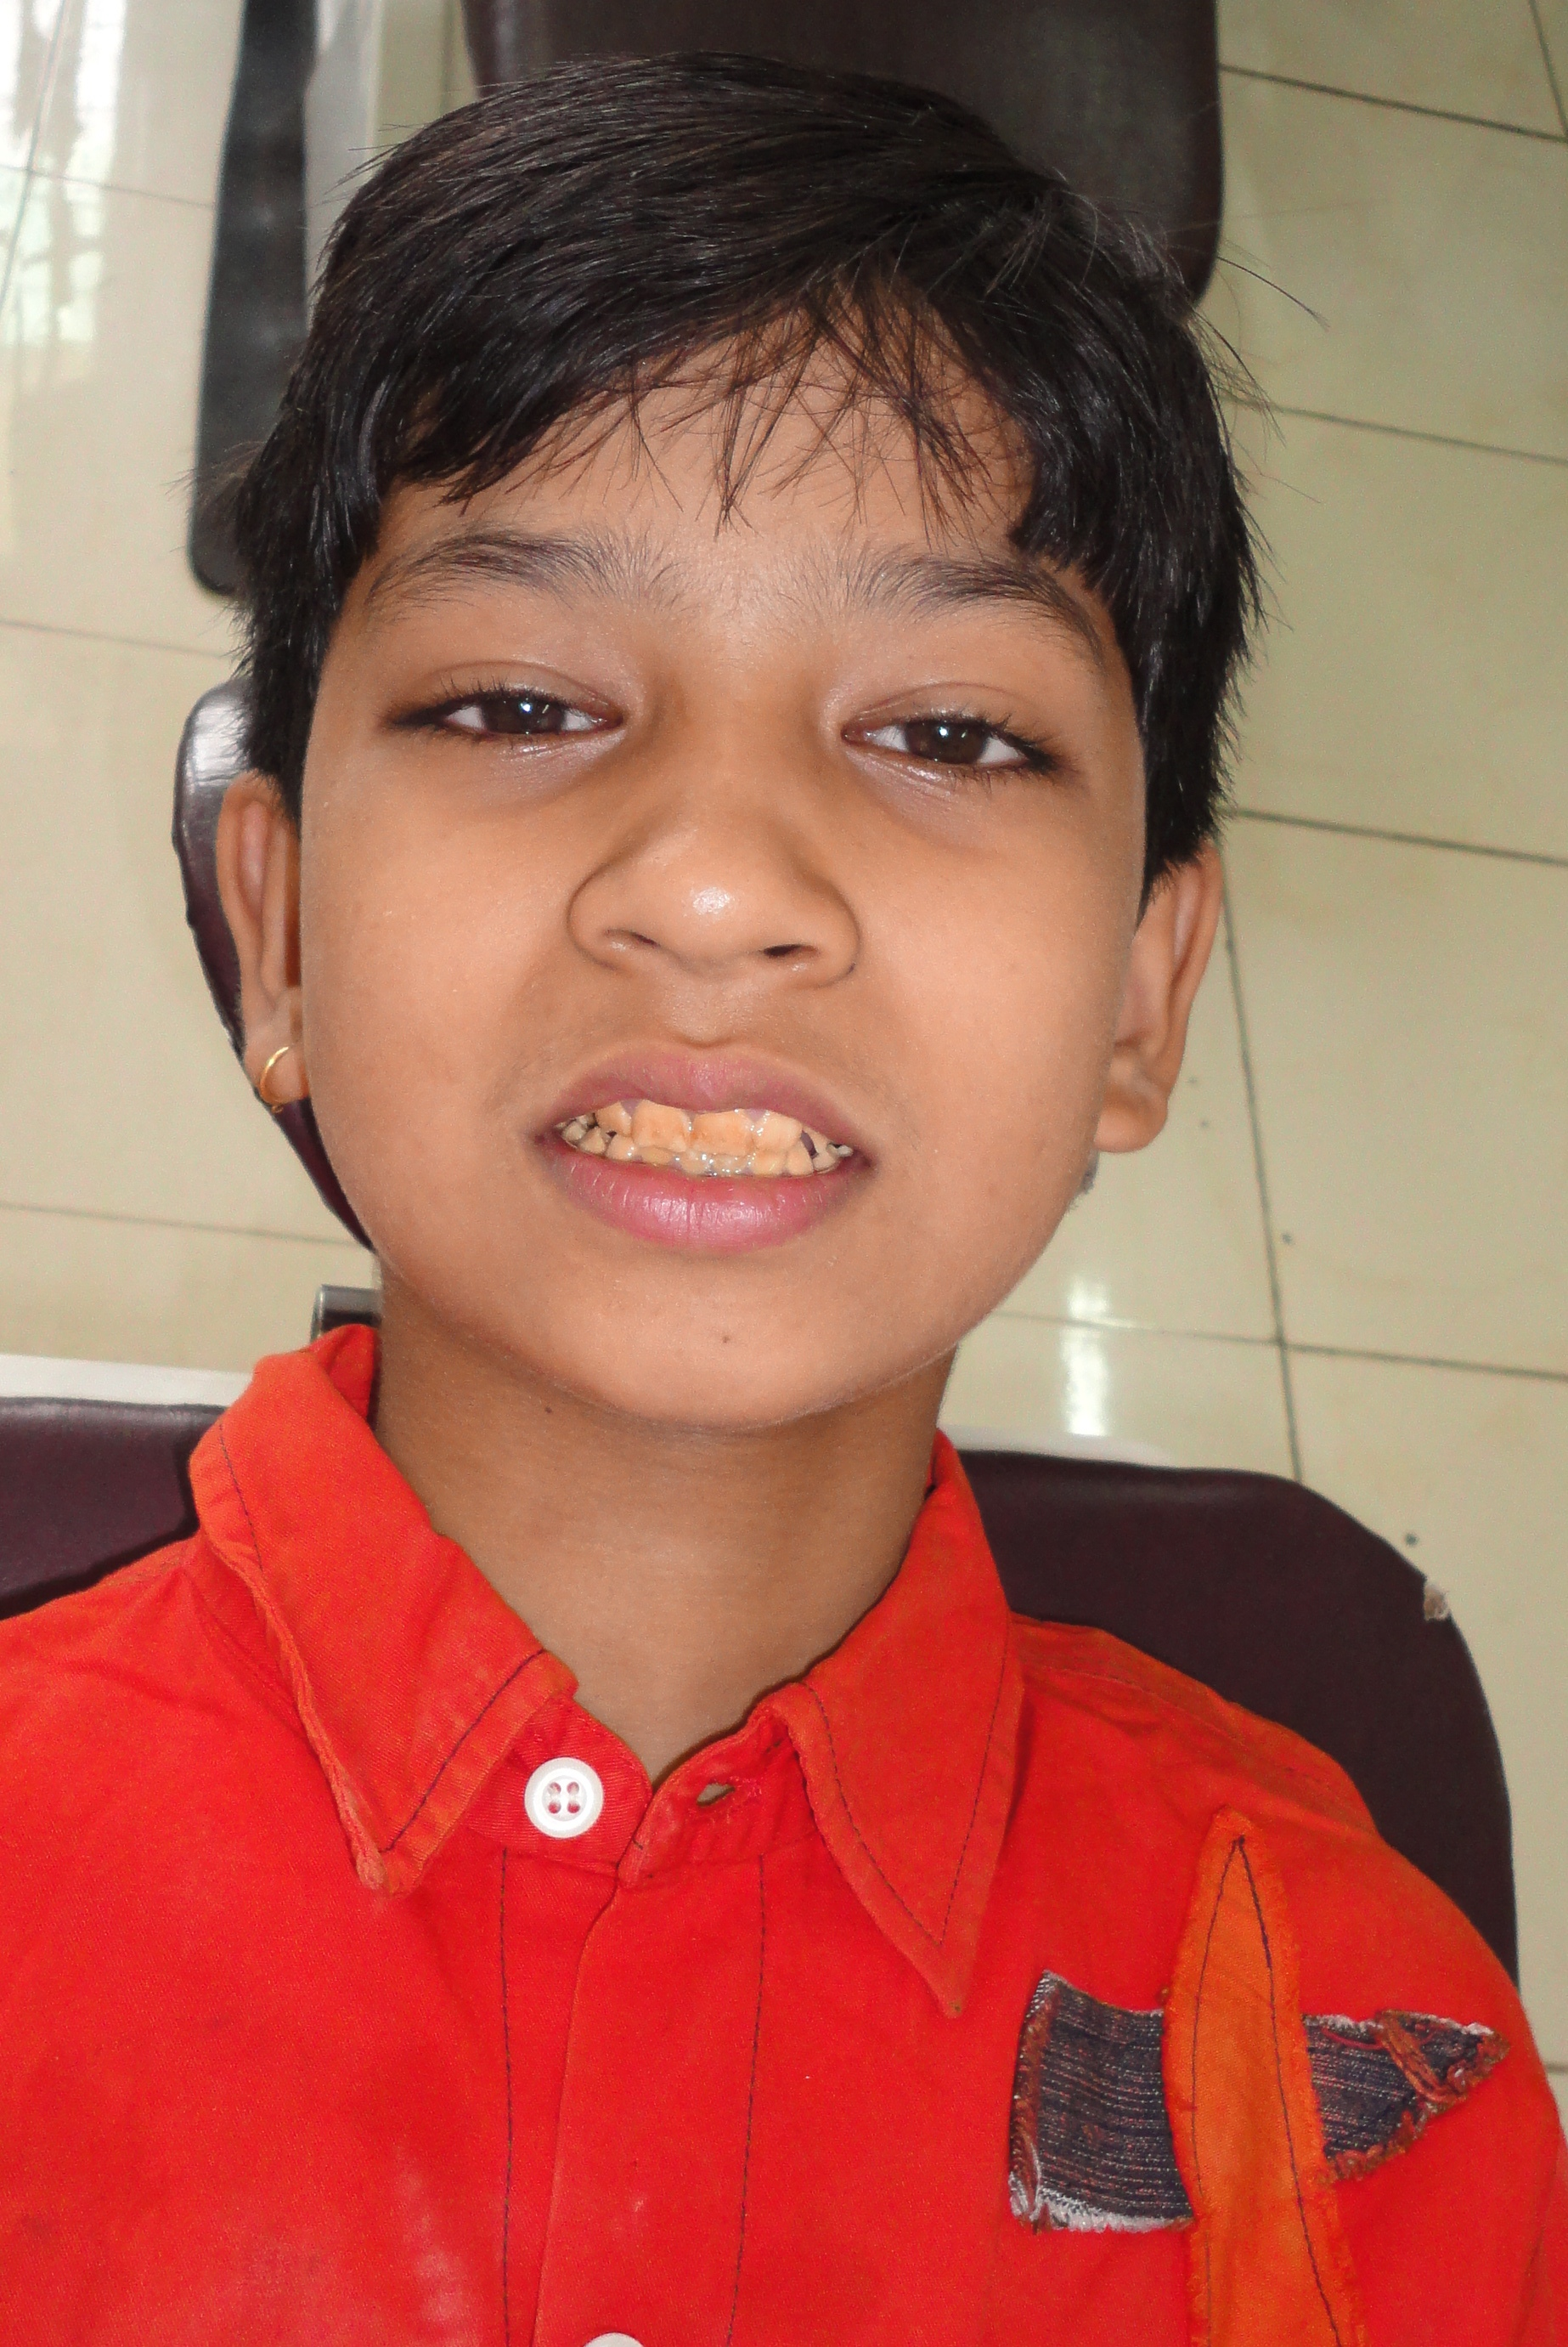

Slide 29
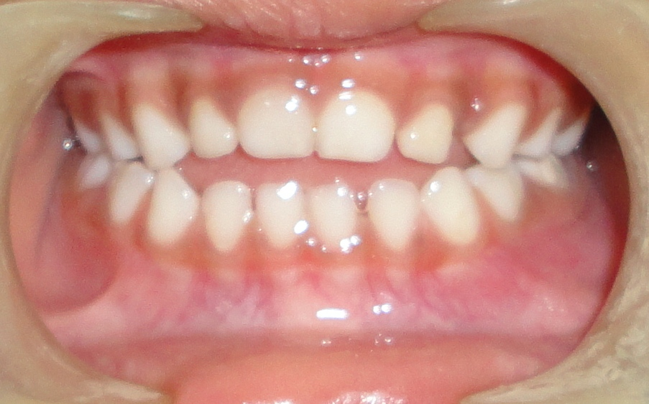
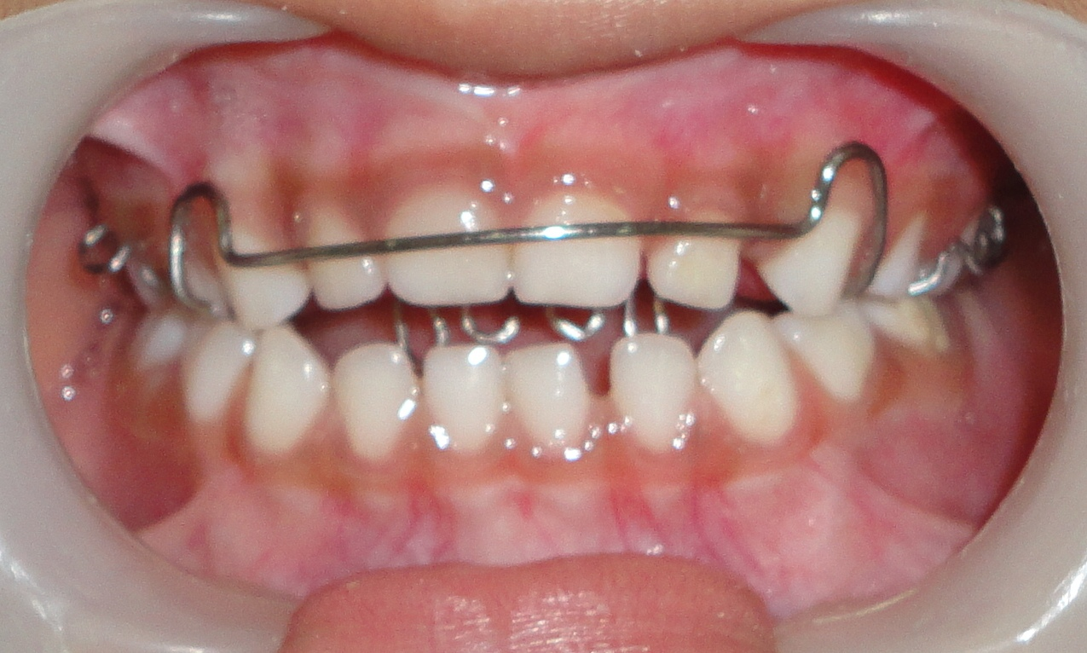
Habit Breaking appliances

Slide 30
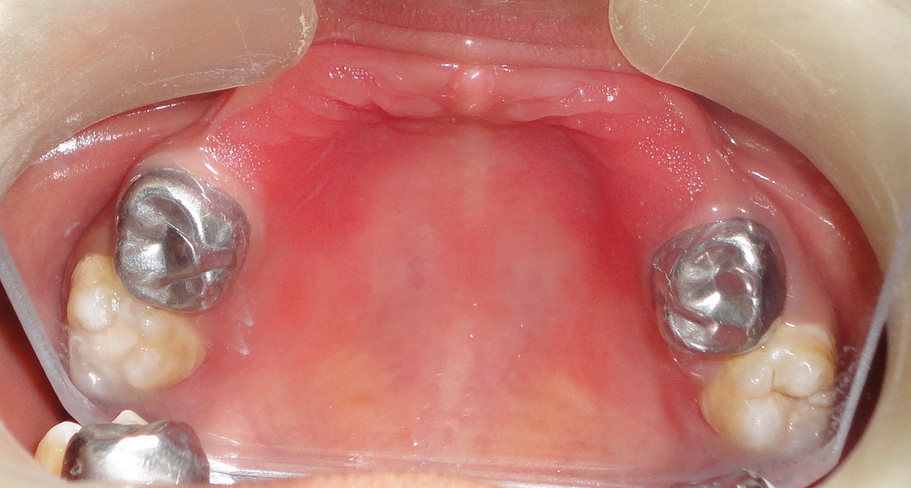
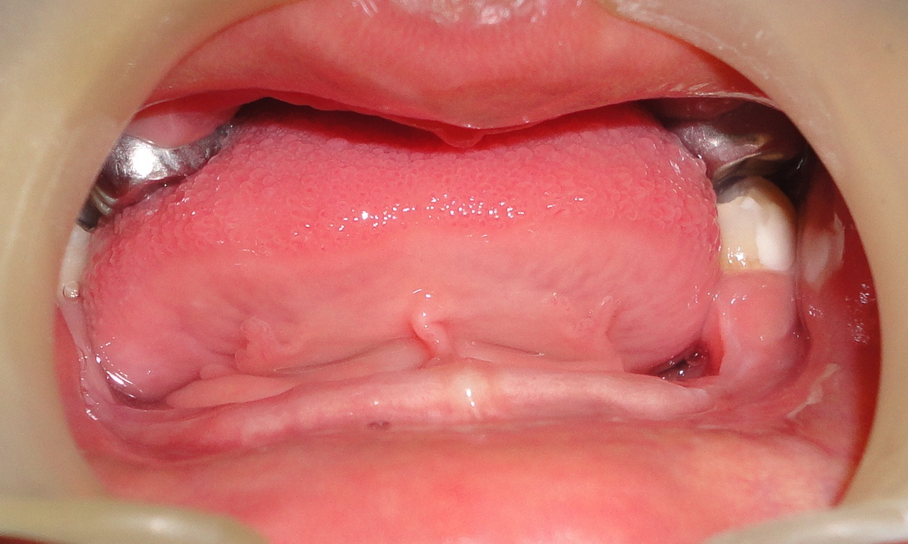

Slide 31
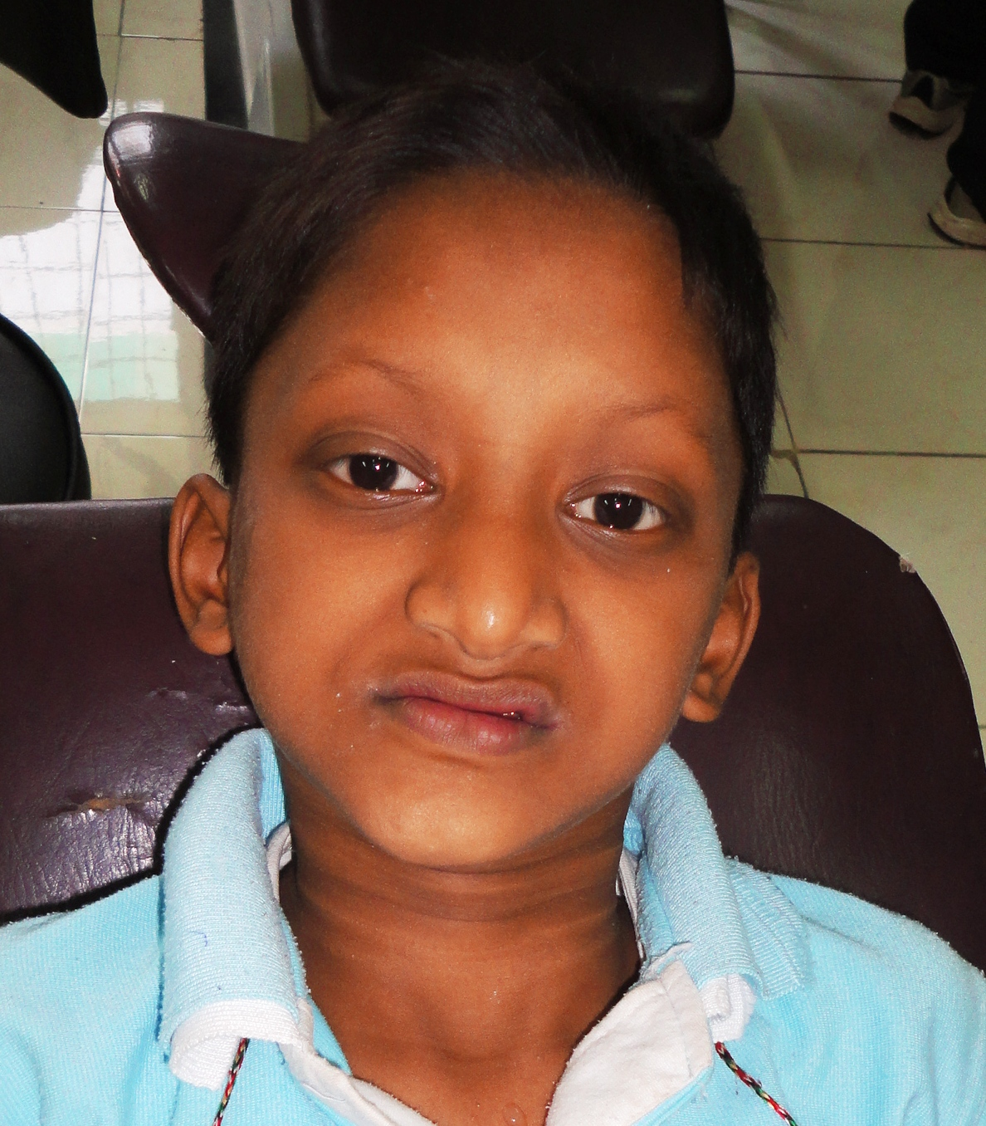
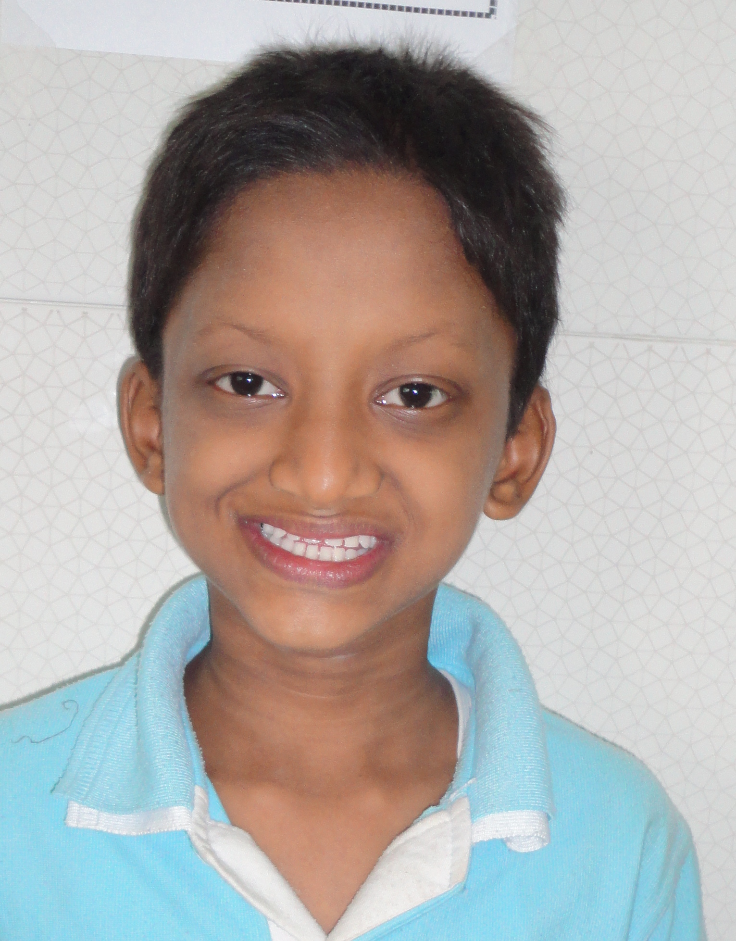

Slide 32
Next time when you see a child
Please give him a choice to have a healthy smile
As every child…….deserves a happy smile!!

